Slide 1
Abstraction-Guided Synthesis of synchronization
Martin Vechev
Eran Yahav
Greta Yorsh
IBM T.J. Watson Research Center

Slide 2
Challenge: Correct and Efficient Synchronization
Process 1
Process 2
Process 3
Shared memory concurrent program
No synchronization: often incorrect (but “efficient”)
Coarse-grained synchronization: easy to reason about, often inefficient
Fine-grained synchronization: hard to reason about, programmer often gets this wrong
Notes:
2

Slide 3
Challenge: Correct and Efficient Synchronization
Process 1
Process 2
Process 3
Shared memory concurrent program
No synchronization: often incorrect (but “efficient”)
Coarse-grained synchronization: easy to reason about, often inefficient
Fine-grained synchronization: hard to reason about, programmer often gets this wrong
Notes:
3

Slide 4
Challenge: Correct and Efficient Synchronization
Process 1
Process 2
Process 3
Shared memory concurrent program
No synchronization: often incorrect (but “efficient”)
Coarse-grained synchronization: easy to reason about, often inefficient
Fine-grained synchronization: hard to reason about, programmer often gets this wrong
Notes:
4

Slide 5
Challenge
Process 1
Process 2
Process 3
How to synchronize processes to achieve correctness and efficiency?
Notes:
5

Slide 6
Synchronization Primitives
Atomic sections
Conditional critical region (CCR)
Memory barriers (fences)
CAS
Semaphores
Monitors
Locks
....
Notes:
6

Slide 7
Example: Correct and Efficient Synchronization with Atomic Sections
P1()
P2()
P3()
{
……………………………
…………………….
…
}
{
………………
……
………………….
…………………….
…………………………
}
{
…………………..
……
…………………….
………………
……………………
}
atomic
atomic
atomic
Safety Specification: S

Slide 8
Example: Correct and Efficient Synchronization with Atomic Sections
P1()
P2()
P3()
{
……………………………
…………………….
…
}
{
………………
……
………………….
…………………….
…………………………
}
{
…………………..
……
…………………….
………………
……………………
}
Safety Specification: S
Assist the programmer by automatically inferring correct and efficient synchronization

Slide 9
Challenge
Find minimal synchronization that makes the program satisfy the specification
Avoid all bad interleavings while permitting as many good interleavings as possible
Assumption: we can prove that serial executions satisfy the specification
Interested in bad behaviors due to concurrency
Handle infinite-state programs

Slide 10
Our Approach
Synthesis of synchronization via abstract interpretation
Compute over-approximation of all possible program executions
Add minimal synchronization to avoid (over-approximation of) bad interleavings
Interplay between abstraction and synchronization
Finer abstraction may enable finer synchronization
Coarse synchronization may enable coarser abstraction

Slide 12
A Standard Approach: Abstraction Refinement
program
Valid
specification
Abstract
counter example
Verify
abstraction

Abstract
counter example
Abstraction Refinement
Change the abstraction to match the program

Slide 13
Our Approach: Abstraction-Guided Synthesis
program
ϕ
P’
Program Restriction
Implement
specification
Abstract counter example
Verify
abstraction

Abstract
counter example
Abstraction Refinement
Change the program to match the abstraction
Notes:
Notes:
Should say here --- could have many solutions, implement is picking one based on quantitative criterion
Constraint captures changes to the program execution --- what is permitted during program execution

Slide 14
AGS Algorithm – High Level
Input: Program P, Specification S, Abstraction 
Output: Program P’ satisfying S under 
ϕ = true
while(true) {
BadTraces = {π | π ∈ (←P→ ∩ ←ϕ→) and π  S }
if (BadTraces is empty) return implement(P,ϕ)
select π ∈ BadTraces
if (?) {
ψ = avoid(π)
if (ψ ≠ false) ϕ = ϕ ∧ ψ
else abort
} else {
’ = refine(, π)
if (’≠ )  = ’
else abort
}
}

Slide 15
Avoid and Implement
Desired output – program satisfying the spec
Implementability guides the choice of constraint language
Examples
Atomic sections [POPL’10]
Conditional critical regions (CCRs) [TACAS’09]
Memory fences (for weak memory models) [FMCAD’10 + abstractions in progress]
…

Slide 16
Avoiding an interleaving with atomic sections
Adding atomicity constraints
Atomicity predicate [l1,l2] – no context switch allowed between execution of statements at l1 and l2
avoid(π)
A disjunction of all possible atomicity predicates that would prevent π
Thread A
A1
A2
Thread B
B1
B2
π = A₁ B₁ A₂ B₂
avoid(π) = [A₁,A₂]  [B₁,B₂]
Notes:
Ability to eliminate a single trace

Slide 17
Avoid and abstraction
ψ = avoid(π)
Enforcing ψ avoids any abstract trace π’ such that π’  ψ
Potentially avoiding “good traces”
Abstraction may affect our ability to avoid a smaller set of traces

Slide 18
Example
T1
1: x += z
2: x += z
T2
1: z++
2: z++
T3
1: y1 = f(x)
2: y2 = x
3: assert(y1 != y2)
f(x) {
if (x == 1) return 3
else if (x == 2) return 6
else return 5
}

Slide 19
Example: Concrete Values
y1
6
5
x += z; x += z; z++;z++;y1=f(x);y2=x;assert ➔ y1=5,y2=0
4
3
2
z++; x+=z; y1=f(x); z++; x+=z; y2=x;assert ➔ y1=3,y2=3
1
0
1
2
3
4
y2
…
Concrete values
T1
1: x += z
2: x += z
T2
1: z++
2: z++
T3
1: y1 = f(x)
2: y2 = x
3: assert(y1 != y2)
f(x) {
if (x == 1) return 3
else if (x == 2) return 6
else return 5
}

Slide 20
Example: Parity Abstraction
y1
y1
6
6
5
5
4
4
3
3
2
2
1
1
0
1
2
3
4
y2
0
1
2
3
4
y2
Concrete values
Parity abstraction (even/odd)
x += z; x += z; z++;z++;y1=f(x);y2=x;assert ➔ y1=Odd,y2=Even
T1
1: x += z
2: x += z
T2
1: z++
2: z++
T3
1: y1 = f(x)
2: y2 = x
3: assert(y1 != y2)
f(x) {
if (x == 1) return 3
else if (x == 2) return 6
else return 5
}

Slide 21
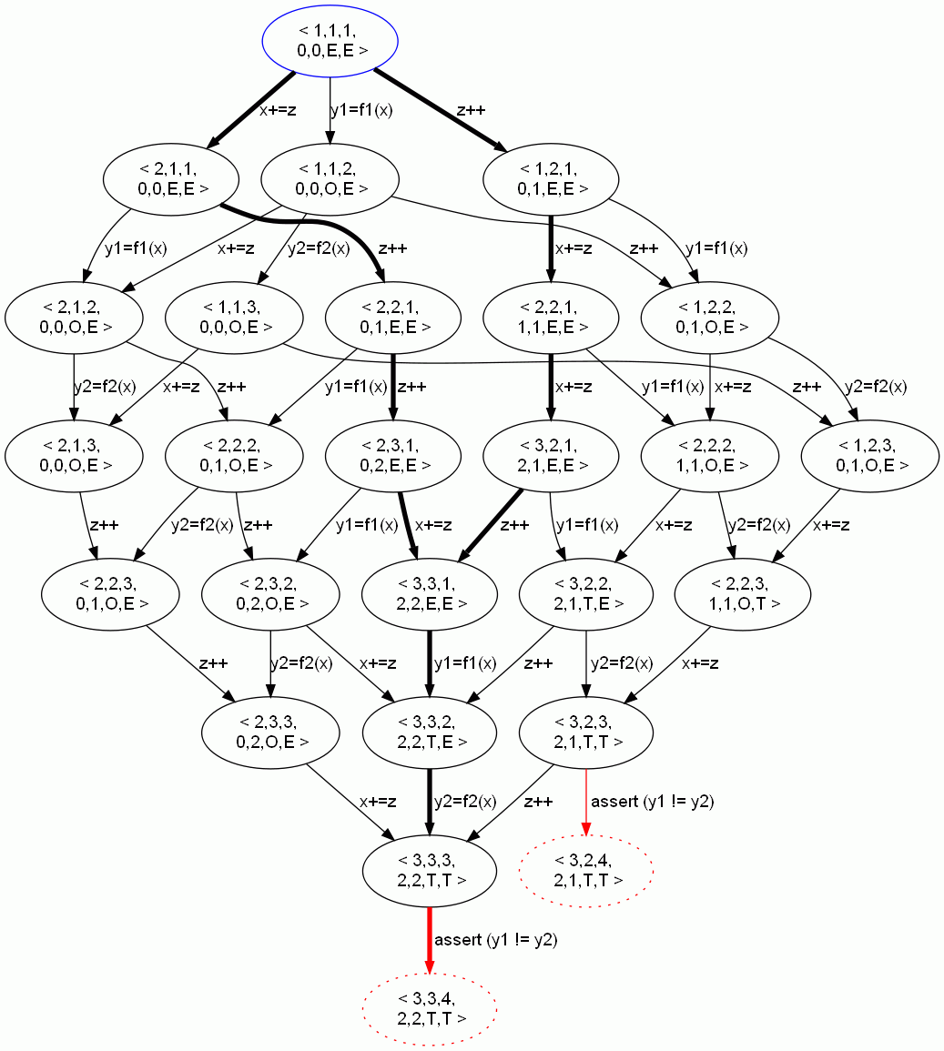
Example: Avoiding Bad Interleavings
ϕ = true
while(true) {
BadTraces={π|π∈(←P→ ∩ ←ϕ→) and
π  S }
if (BadTraces is empty)
return implement(P,ϕ)
select π ∈ BadTraces
if (?) {
ϕ = ϕ ∧ avoid(π)
} else {
 = refine(, π)
}
}
avoid(π₁) = [z++,z++]
ϕ = [z++,z++]
ϕ = true

Slide 22
Example: Avoiding Bad Interleavings
ϕ = true
while(true) {
BadTraces={π|π∈(←P→ ∩ ←ϕ→) and
π  S }
if (BadTraces is empty)
return implement(P,ϕ)
select π ∈ BadTraces
if (?) {
ϕ = ϕ ∧ avoid(π)
} else {
 = refine(, π)
}
}
avoid(π₂) =[x+=z,x+=z]
ϕ = [z++,z++]
ϕ = [z++,z++]∧[x+=z,x+=z]

Slide 23
Example: Avoiding Bad Interleavings
T1
1: x += z
2: x += z
ϕ = true
while(true) {
BadTraces={π|π∈(←P→ ∩ ←ϕ→) and
π  S }
if (BadTraces is empty)
return implement(P,ϕ)
select π ∈ BadTraces
if (?) {
ϕ = ϕ ∧ avoid(π)
} else {
 = refine(, π)
}
}
T2
1: z++
2: z++
T3
1: y1 = f(x)
2: y2 = x
3: assert(y1 != y2)
ϕ = [z++,z++]∧[x+=z,x+=z]

Slide 24
Example: Avoiding Bad Interleavings
parity
y1

parity

parity

T1
x+=z; x+=z
6
T1
x+=z; x+=z
6
T1
x+=z; x+=z
6
5
5
5
T2
z++;
z++;
4
T2
z++;
z++;
4
T2
z++;
z++;
4
3
3
3
T3
y1=f(x)
y2=x
assert
y1!= y2
T3
y1=f(x)
y2=x
assert
y1!= y2
T3
y1=f(x)
y2=x
assert
y1!= y2
2
2
2
1
1
1
0
1
2
3
4
y2
0
1
2
3
4
0
1
2
3
4
But we can also refine the abstraction…

Slide 25
parity
y1
✗
parity
✗
parity
✓
T1
x+=z; x+=z
6
T1
x+=z; x+=z
6
T1
x+=z; x+=z
6
5
5
5
T2
z++;
z++;
4
T2
z++;
z++;
4
T2
z++;
z++;
4
3
3
3
T3
y1=f(x)
y2=x
assert
y1!= y2
T3
y1=f(x)
y2=x
assert
y1!= y2
T3
y1=f(x)
y2=x
assert
y1!= y2
2
2
2
1
1
1
(a)
0
1
2
3
4
y2
(b)
0
1
2
3
4
(c)
0
1
2
3
4
interval
✗
interval
✓
T1
x+=z; x+=z
6
T1
x+=z; x+=z
6
5
5
T2
z++;
z++;
4
T2
z++;
z++;
4
3
3
T3
y1=f(x)
y2=x
assert
y1!= y2
2
T3
y1=f(x)
y2=x
assert
y1!= y2
2
1
1
(d)
0
1
2
3
4
(e)
0
1
2
3
4
octagon
✗
octagon
✓
T1
x+=z; x+=z
6
T1
x+=z; x+=z
6
5
5
T2
z++;
z++;
4
T2
z++;
z++;
4
3
3
T3
y1=f(x)
y2=x
assert
y1!= y2
2
T3
y1=f(x)
y2=x
assert
y1!= y2
2
1
1
(f)
0
1
2
3
4
(g)
0
1
2
3
4

Slide 26
Multiple Solutions
Performance: smallest atomic sections
Interval abstraction for our example produces the atomicity constraint: ([x+=z,x+=z] ∨ [z++,z++]) ∧ ([y1=f(x),y2=x] ∨ [x+=z,x+=z] ∨ [z++,z++])
Minimal satisfying assignments
₁ = [z++,z++]
₂ = [x+=z,x+=z]

Slide 27
AGS Algorithm – More Details
Forward Abstract Interpretation, taking ϕ into account for pruning infeasible interleavings
Input: Program P, Specification S, Abstraction 
Output: Program P’ satisfying S under 
ϕ = true
while(true) {
BadTraces = {π | π ∈ (←P→ ∩ ←ϕ→) and π  S }
if (BadTraces is empty) return implement(P,ϕ)
select π ∈ BadTraces
if (?) {
ψ = avoid(π)
if (ψ ≠ false) ϕ = ϕ ∧ ψ
else abort
} else {
’ = refine(, π)
if (’≠ )  = ’
else abort
}
}
Order of selection matters
Choosing between abstraction refinement and program restriction
not always possible to refine/avoid
may try and backtrack
Backward exploration of invalid Interleavings using ϕ to prune infeasible interleavings.
Up to this point did not commit to a synchronization mechanism
Notes:
Notes:
In general, both “avoid” and “implement” are pluggable procedures
Language of constraints may need to be adapted though

Slide 28
Choosing a trace to avoid
0,0 0,0
0,0 E,E
y=2
if (y==0)
y=2
if (y==0)
0,1 0,2
2,0 0,0
0,1 E,E
2,0 E,E
if (y==0)
y=2
if (y==0)
1,1 0,2
2,1 0,2
1,1 E,E
y=2
x++
x+=1
x++
2,1 1,2
2,2 1,2
2,1 T,E
x+=1
x+=1
x+=1
2,2 2,2
2,2 T,E
T1
0: if (y==0) goto L
1: x++
2: L:
T2
0: y=2
1: x+=1
2: assert x !=y
legend
pc1,pc2 x,y
Notes:
Goal: show that the order in which you pick traces matters

Slide 29
Implementability
Separation between schedule constraints and how they are realized
Can realize in program: atomic sections, locks,…
Can realize in scheduler: benevolent scheduler
T1
1: while(*) {
2: x++
3: x++
4: }
T2
1: assert (x != 1)
No program transformations (e.g., loop unrolling)
Memoryless strategy

Slide 30
Atomic sections results
If we can show disjoint access we can avoid synchronization
Requires abstractions rich enough to capture access pattern to shared data
Parity
Intervals
Program | Refine Steps | Avoid Steps
Double buffering | 1 | 2
Defragmentation | 1 | 8
3D array update | 2 | 23
Array Removal | 1 | 17
Array Init | 1 | 56

Slide 31
AGS with guarded commands
Implementation mechanism: conditional critical region (CCR)
Constraint language: Boolean combinations of equalities over variables (x == c)
Abstraction: what variables a guard can observe
guard → stmt

Slide 32
Avoiding a transition using a guard
s₁
x=1, y=1, z=0
y=x+1
z=y+1
s₂
s₃
x=1, y=2, z=0
x=1, y=1, z=2
Add guard to z = y+1 to prevent execution from state s₁
Guard for s₁ : (x  1  y  1  z  0)
Can affect other transitions where z = y+1 is executed

Slide 33
Example: full observability
T1
1: x = z + 1
T2
1: y = x + 1
T3
1: z = y + 1
Specification:
(y = 2  z = 1)
No Stuck States
Abstraction:
{ x, y, z }
Notes:
Spec is a global invariant.

Slide 34
Build Transition System
PC2
PC1
PC3
1,1,1 0,0,0
1,1,1 0,0,0
X
Y
Z
x=z+1
y=x+1
z=y+1
legend
e,1,1 1,0,0
1,e,1 0,1,0
1,1,e 0,0,1
y=x+1
z=y+1
z=y+1
y=x+1
x=z+1
x=z+1
e,e,1 1,2,0
e,1,e 1,0,1
e,e,1 1,1,0
1,e,e 0,1,2
e,1,e 2,0,1
1,e,e 0,1,1
z=y+1
y=x+1
z=y+1
x=z+1
y=x+1
x=z+1
e,e,e1,2,3
e,e,e 1,2,1
e,e,e 1,1,2
e,e,e3,1,2
e,e,e,2,3,1
e,e,e2,1,1
Notes:
Say what are the contents of the circles.
34

Slide 35
Avoid transition
1,1,1 0,0,0
x=z+1
y=x+1
z=y+1
e,1,1 1,0,0
1,e,1 0,1,0
1,1,e 0,0,1
y=x+1
z=y+1
z=y+1
y=x+1
x=z+1
x=z+1
e,e,1 1,2,0
e,1,e 1,0,1
e,e,1 1,1,0
1,e,e 0,1,2
e,1,e 2,0,1
1,e,e 0,1,1
z=y+1
y=x+1
z=y+1
x=z+1
y=x+1
x=z+1
e,e,e1,2,3
e,e,e 1,2,1
e,e,e 1,1,2
e,e,e3,1,2
e,e,e,2,3,1
e,e,e2,1,1
Notes:
35

Slide 36
Result is valid
✓
Correct and Maximally Permissive
1,1,1 0,0,0
x1  y0  z0 →
x=z+1
y=x+1
z=y+1
e,1,1 1,0,0
1,e,1 0,1,0
1,1,e 0,0,1
x1  y0  z0 →
y=x+1
x1  y0  z0 → z=y+1
z=y+1
y=x+1
x=z+1
x=z+1
e,e,1 1,2,0
e,1,e 1,0,1
e,e,1 1,1,0
1,e,e 0,1,2
e,1,e 2,0,1
1,e,e 0,1,1
x1  y0  z0 →
x1  y0  z0 →
z=y+1
y=x+1
z=y+1
x=z+1
y=x+1
x=z+1
e,e,e1,2,3
e,e,e 1,2,1
e,e,e 1,1,2
e,e,e3,1,2
e,e,e,2,3,1
e,e,e2,1,1
Notes:
36

Slide 37
Resulting program
T1
1: x = z + 1
T2
1: y = x + 1
T3
1: z = y + 1
Specification:
Abstraction:
 (y = 2  z = 1)
No Stuck States
{ x, y, z }
T1
1: x = z + 1
T2
1: y = x + 1
T3
1: (x  1  y  0  z  0)→ z = y + 1
Notes:
Spec is a global invariant.

Slide 38
Example: limited observability
T1
1: x = z + 1
T2
1: y = x + 1
T3
1: z = y + 1
Specification:
 (y = 2  z = 1)
No Stuck States
Abstraction:
{ x, z }
Notes:
Spec is a global invariant.

Slide 39
Build transition system
PC2
PC1
PC3
1,1,1 0,0,0
1,1,1 0,0,0
X
Y
Z
x=z+1
y=x+1
z=y+1
legend
e,1,1 1,0,0
1,e,1 0,1,0
1,1,e 0,0,1
y=x+1
z=y+1
z=y+1
y=x+1
x=z+1
x=z+1
e,e,1 1,2,0
e,1,e 1,0,1
e,e,1 1,1,0
1,e,e 0,1,2
e,1,e 2,0,1
1,e,e 0,1,1
z=y+1
y=x+1
z=y+1
x=z+1
y=x+1
x=z+1
e,e,e1,2,3
e,e,e 1,2,1
e,e,e 1,1,2
e,e,e3,1,2
e,e,e,2,3,1
e,e,e2,1,1
Notes:
39

Slide 40
Avoid bad state
1,1,1 0,0,0
x=z+1
y=x+1
z=y+1
e,1,1 1,0,0
1,e,1 0,1,0
1,1,e 0,0,1
y=x+1
z=y+1
z=y+1
y=x+1
x=z+1
x=z+1
e,e,1 1,2,0
e,1,e 1,0,1
e,e,1 1,1,0
1,e,e 0,1,2
e,1,e 2,0,1
1,e,e 0,1,1
z=y+1
y=x+1
z=y+1
x=z+1
y=x+1
x=z+1
e,e,e1,2,3
e,e,e 1,2,1
e,e,e 1,1,2
e,e,e3,1,2
e,e,e,2,3,1
e,e,e2,1,1
Notes:
40

Slide 41
Select all equivalent transitions
1,1,1 0,0,0
x=z+1
y=x+1
z=y+1
e,1,1 1,0,0
1,e,1 0,1,0
1,1,e 0,0,1
y=x+1
z=y+1
z=y+1
y=x+1
x=z+1
x=z+1
e,e,1 1,2,0
e,1,e 1,0,1
e,e,1 1,1,0
1,e,e 0,1,2
e,1,e 2,0,1
1,e,e 0,1,1
z=y+1
y=x+1
z=y+1
x=z+1
y=x+1
x=z+1
e,e,e1,2,3
e,e,e 1,2,1
e,e,e 1,1,2
e,e,e3,1,2
e,e,e,2,3,1
e,e,e2,1,1
Implementability
Notes:
41

Slide 42
Result has stuck states
1,1,1 0,0,0
x1  z0 →
x=z+1
y=x+1
z=y+1
e,1,1 1,0,0
1,e,1 0,1,0
1,1,e 0,0,1
y=x+1
x1  z0 →
x1  z0 →
z=y+1
z=y+1
y=x+1
x=z+1
x=z+1
e,e,1 1,2,0
e,1,e 1,0,1
e,e,1 1,1,0
1,e,e 0,1,2
e,1,e 2,0,1
1,e,e 0,1,1
x1  z0 →
z=y+1
y=x+1
z=y+1
x=z+1
y=x+1
x=z+1
e,e,e1,2,3
e,e,e 1,2,1
e,e,e 1,1,2
e,e,e3,1,2
e,e,e,2,3,1
e,e,e2,1,1
side-effects
Notes:
42

Slide 43
Select transition to remove
1,1,1 0,0,0
x1  z0 →
x=z+1
y=x+1
z=y+1
e,1,1 1,0,0
1,e,1 0,1,0
1,1,e 0,0,1
y=x+1
x1  z0 →
x1  z0 →
z=y+1
z=y+1
y=x+1
x=z+1
x=z+1
e,e,1 1,2,0
e,1,e 1,0,1
e,e,1 1,1,0
1,e,e 0,1,2
e,1,e 2,0,1
1,e,e 0,1,1
x  1  z  0 →
z=y+1
y=x+1
z=y+1
x=z+1
y=x+1
x=z+1
e,e,e1,2,3
e,e,e 1,2,1
e,e,e 1,1,2
e,e,e3,1,2
e,e,e,2,3,1
e,e,e2,1,1
Notes:
43

Slide 44
Result is valid
✓
Correct and Maximally Permissive
1,1,1 0,0,0
x0  z0 →
x  1  z  0 →
x=z+1
y=x+1
z=y+1
e,1,1 1,0,0
1,e,1 0,1,0
1,1,e 0,0,1
y=x+1
x1  z0 →
x  1  z  0 →
x  0  z  0→
z=y+1
z=y+1
x0  z0 →
y=x+1
x=z+1
x=z+1
e,e,3 1,2,0
e,2,e 1,0,1
e,e,3 1,1,0
1,e,e 0,1,2
e,1,e 2,0,1
1,e,e 0,1,1
x1  z0 →
x1  z0 →
x  0  z  0 →
x0  z0 →
z=y+1
y=x+1
z=y+1
x=z+1
y=x+1
x=z+1
e,e,e1,2,3
e,e,e 1,2,1
e,e,e 1,1,2
e,e,e3,1,2
e,e,e,2,3,1
e,e,e2,1,1

Slide 45
Resulting program
T1
1: x = z + 1
T2
1: y = x + 1
T3
1: z = y + 1
Specification:
Abstraction:
! (y = 2 && z = 1)
No Stuck States
{ x, z }
T1
1: (x  0  z  0)→
x = z + 1
T2
1: y = x + 1
T3
1: (x  1  z  0) →
z = y + 1
Notes:
Spec is a global invariant.

Slide 46
{ x }
✗
✗
✗
T1
x = z + 1
T2
y = x + 1
T3
z = y + 1
T1
x = z + 1
T2
y = x + 1
T3
(x  1)→ z = y + 1
T1
(x  0)→ x = z + 1
T2
y = x + 1
T3
(x  1)→ z = y + 1
{ x,z }
✗
✗
✓
T1
x = z + 1
T2
y = x + 1
T3
z = y + 1
T1
x = z + 1
T2
y = x + 1
T3
(x  1  z  0) → z = y + 1
T1
(x  0  z  0)→ x = z + 1
T2
y = x + 1
T3
(x  1  z  0) → z = y + 1
{ x,y,z }
✗
✓
T1
x = z + 1
T2
y = x + 1
T3
z = y + 1
T1
x = z + 1
T2
y = x + 1
T3
(x  1  y  0  z  0)→ z = y + 1

Slide 47
AGS with memory fences
Avoidable transition more tricky to define
Operational semantics of weak memory models
Special abstraction required to deal with potentially unbounded store-buffers
Even for finite-state programs
Informally “finer abstraction = fewer fences”

Slide 48
Some AGS instances
Avoid | Implementation Mechanism | Abstraction Space (examples) | Reference
Context switch | Atomic sections | Numerical abstractions | [POPL’10]
Transition | Conditional critical regions (CCRs) | Observability | [TACAS’09]
Reordering | Memory fences | Partial-Coherence abstractions for Store buffers | [FMCAD’10] [in progress]
 | …

Slide 49
General Setting Revisited
program
ϕ
P’
Program Restriction
Implement
specification
Abstract counter example
S’
Verify
Spec Weakening
Σ
abstraction

Abstract
counter example
Abstraction Refinement
Change the specification to match the abstraction
Notes:
Notes:
Should say here --- could have many solutions, implement is picking one based on quantitative criterion
Constraint captures changes to the program execution --- what is permitted during program execution

Slide 50
Summary
An algorithm for Abstraction-Guided Synthesis
Synthesize efficient and correct synchronization
Handles infinite-state systems based on abstract interpretation
Refine the abstraction and/or restrict program behavior
Interplay between abstraction and synchronization
Quantitative Synthesis
Separate characterization of solution from choosing optimal solutions (e.g., smallest atomic sections)

Slide 51
Invited Questions
What about other synchronization mechanisms?
Why not start from the most constrained program and work downwards (relaxing constraints)?
Can’t you solve the problem purely by brute force search of all atomic section placements?
Why are you enumerating traces? Can’t you compute your solution via state-based semantics?
Why use only a single CEX at a time? Could use information about the whole (abstract) transition system?
How is this related to supervisor synthesis?

Slide 52
“Don't answer the question you were asked. Answer the question you wish you were asked.” -- Robert McNamara

