Slide 1
QVM
An Efficient Runtime for Detecting Defects
in Deployed Systems
Matt Arnold
Martin Vechev
Eran Yahav

Slide 2



The Bigger Picture
Synthesis
Dynamic
Software
Quality
Static

Slide 3

SAFE: Scalable and Flexible Error-detection and Verification
Lightweight verification for (real) Java programs
Typestate properties
  e.g., “don’t read from a file after it has been closed”
Typestate verification in presence of aliasing [ISSTA’06]
Static Specification Mining [ISSTA’07]
Modular Typestate [POPL’08]
Verifying Dereference Safety via Expanding-Scope Analysis [ISSTA’08]
…
Chandra, Dor, Fink, Geay, Loginov, Pistoia, Ramalingam, Shoham, Yorsh

Slide 4
Challenges
Millions of lines of code?
What properties should we check?
How can we get specifications?

Slide 5

Make writing specs more rewarding
Mother Teresa

Slide 6
Make writing specs more rewarding
Enable developer to write runtime checks
without having to worry about performance impact
Expressive assertions
  beyond what is (naturally/efficiently) expressible in the programming language
Monitoring of global properties
Collection of debug information when a property is violated

Slide 7

Making your specs pay off
Phase | Defect Removal Cost Multiplier
Requirements | 1
Design | 3
Code,Unit Test | 5
Function/System Test | 12
User Acceptance Test | 32
Production | 95

Slide 8
Challenges
Predictable overhead
Expressive assertions
Helping find a fix

Slide 9
QVM: Quality-aware VM
Leverage available system resources for software quality checks
Adaptive overhead management
  QVM monitors overhead it incurs, adapts analyses to meet user specified target overhead
  No free lunches – allow “unknown” result
Support a variety of analysis clients
  Typestate properties
  Heap probes
  Java assertions
Improve Diagnosability
  Collect (sampled) debug information

Slide 10
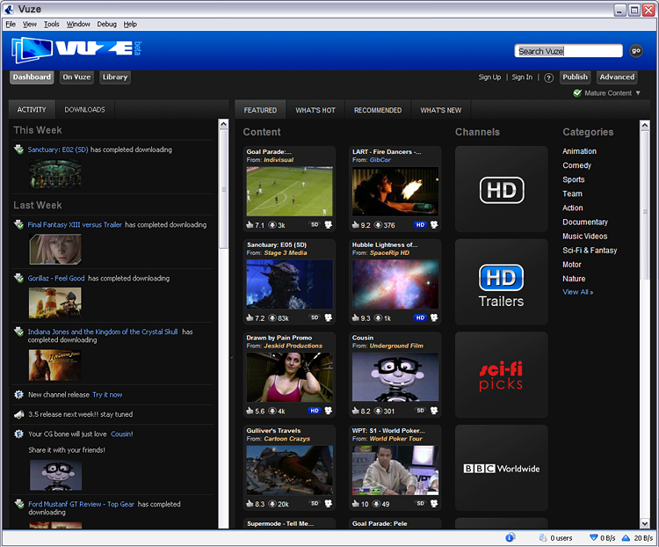
Motivating Example: Azureus
Over 160 million downloads

Slide 11
QVM: GDI Resource Leaks
QVM ERROR: [Resource_not_disposed] object [0x98837030]
of class [org/eclipse/swt/graphics/Image]
allocated at site ID 2742 in method
[com/aelitis/azureus/.../ListView.handleResize(Z)V]
died in state [UNDISPOSED]
with last QVM method [org/.../Image.isDisposed()Z].

Slide 12
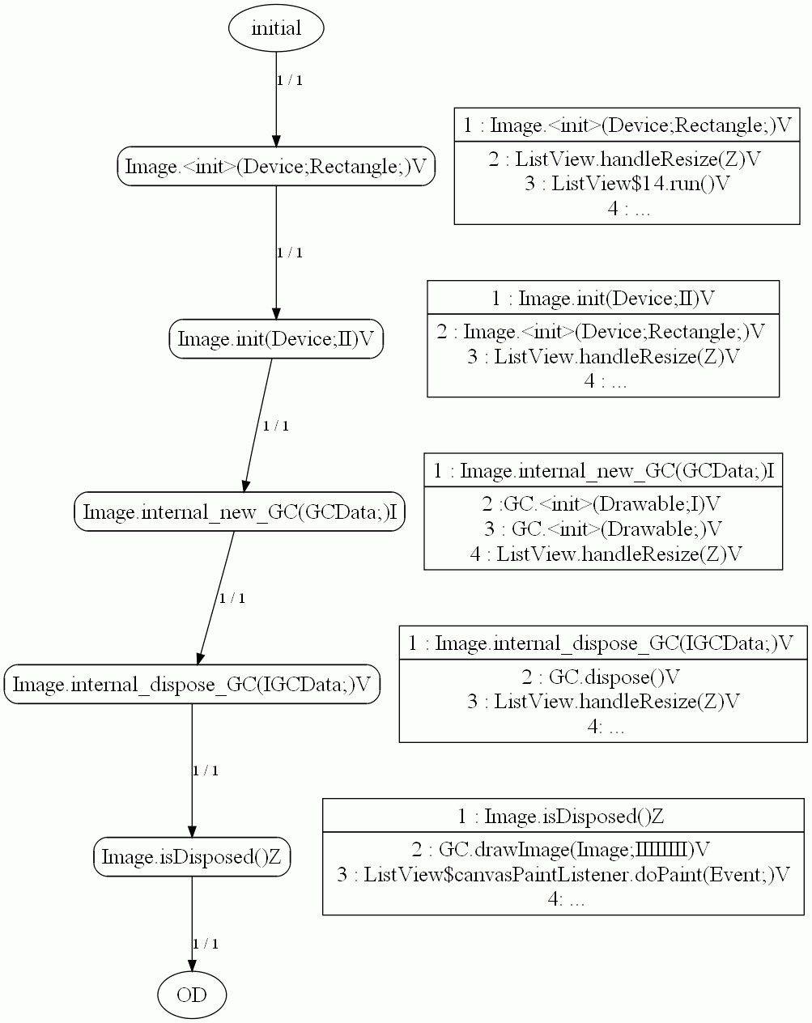

Slide 14
Example Leaking Code
OS
Resources
class ListView extends ... {
private Image imgView = null;
// ...
protected void handleResize(boolean bForce) {
// ...
if (imgView == null || bForce) {
imgView = new Image(listCanvas.getDisplay(), clientArea);
lastBounds = new Rectangle(0, 0, 0, 0);
bNeedsRefresh = true;
} else {
// ...
}
// ...
}
}
imgView
OS
Resources

Slide 15
Possible Fix
OS
Resources
protected void handleResize(boolean bForce) {
// ...
if (imgView == null || bForce) {
if(imgView != null && !imgView.isDisposed()) {
assert(!QVM.isShared (imgView));
imgView.dispose();
}
imgView = new Image(listCanvas.getDisplay(), clientArea);
lastBounds = new Rectangle(0, 0, 0, 0);
bNeedsRefresh = true;
} else {
// ...
}
// ...
}
imgView
OS
Resources

Slide 16
QVM Architecture
Application
typestate
specs
typestate
client
heap probes
client
assertions
client
violations
report
Clients
QVMI
observed overhead
event
filters
event
callbacks
specified
overhead
OHM
Execution
Engine
adjust sampling rates
VM Core
QVM

Slide 17
QVMI: The QVM Interface
Key: filtering on the VM side
agent
event
filters
event
filters
JVMTI
QVMI
event
callbacks
event
callbacks
VM
Execution
Engine
Execution
Engine

Slide 18
Overhead Manager (OHM)
Monitoring: measure overhead incurred by clients
Sampling strategy: separate sampling rates for different origins
Controller: adjust strategy per origin based on measured overhead
QVMI
observed overhead
event
filters
event
callbacks
specified
overhead
OHM
Execution
Engine
adjust sampling rates
VM Core

Slide 19
Overhead Manager
cnt
reset
5
6
assert (…)
3
8
T t = new T()
2
16
assert(…)
Sampling Information
Average time per origin (cycles)

Slide 20
Object Centric Sampling
assert (…)
tracked
tracked
T t = new T()
assert(…)

Slide 21
Clients
Typestate Properties
  With debug information (typestate histories)
  Including times
Heap Probes & Operations
  Check ownership/sharing/shape properties
  Runtime support for transfer of ownership
Java Assertions
Overhead of all clients managed by OHM

Slide 22
Typestate Properties
*
dispose*
| release*
disposed
else
undisposed
err
Object
death
*

Slide 23
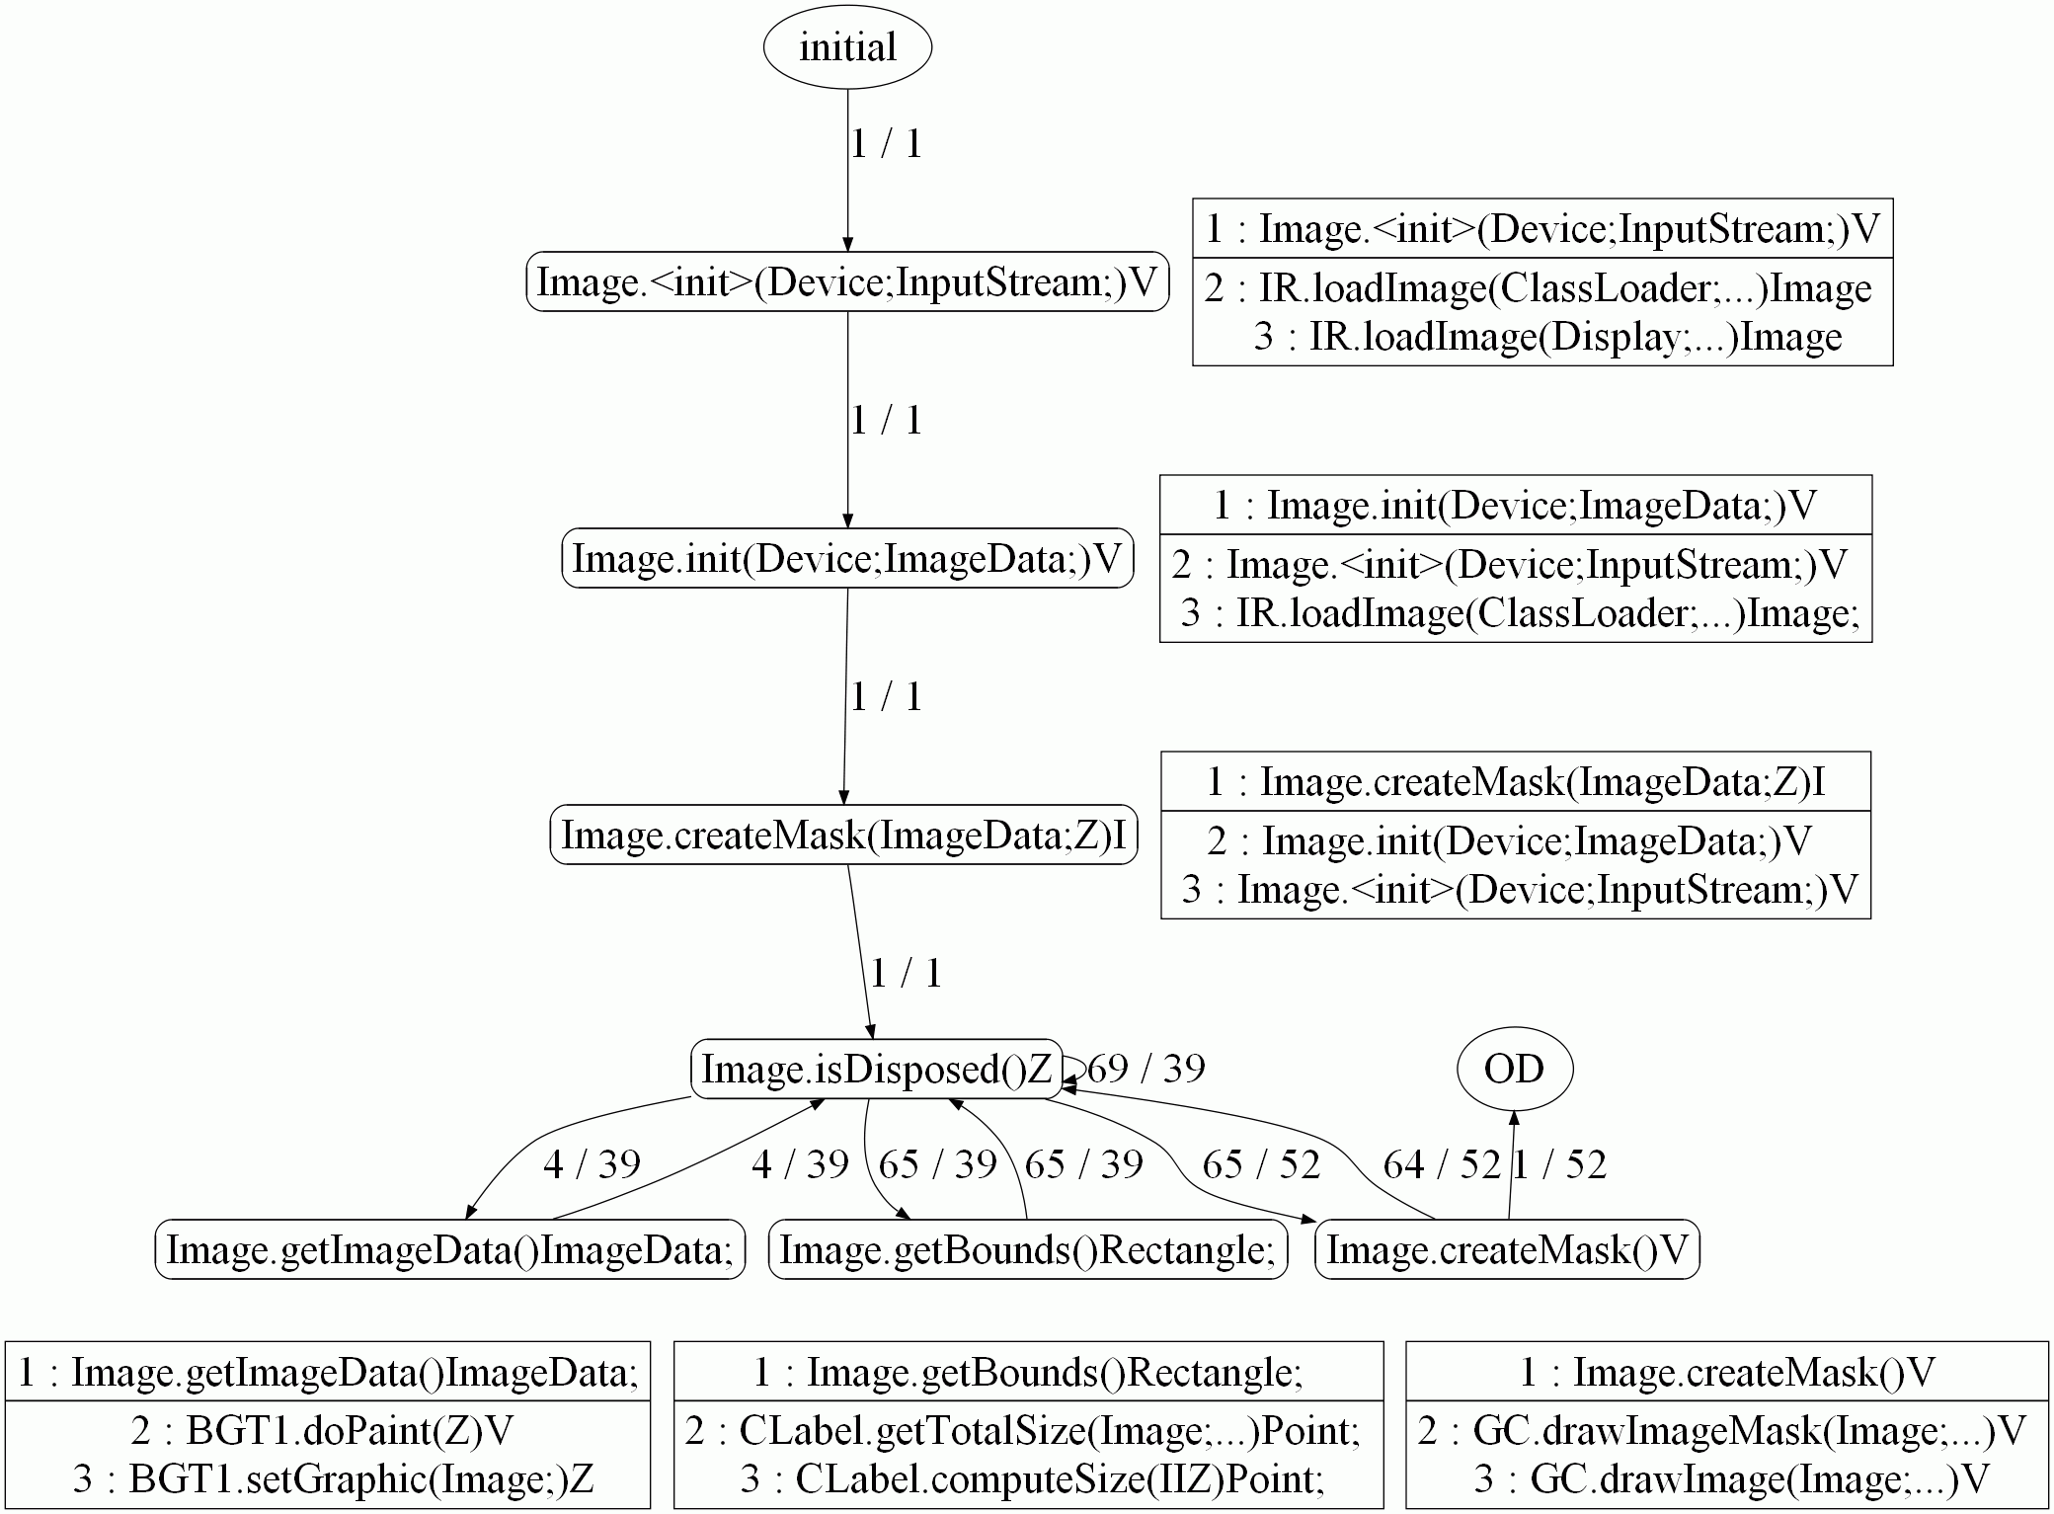
Typestate History

Slide 24
Typestate History

Slide 25
Heap Probes & Operations
Heap Probes
  Ownership and sharing properties
  Reachability…
Heap Operations
  Runtime support for transfer of ownership
Use components of a parallel GC to evaluate heap queries

Slide 26
Heap Probes: isHeap
x
z
A
B
w
y
T1 Stack
T2 Stack
C
Shared Memory
isHeap(x) = false
isHeap(z) = true
isHeap(w) = true
Notes:
isHeap(Object o) Returns true if object o is pointed to by a heap object, false otherwise
isShared(Object o) Returns true if object o is pointed to by two or more heap objects, false otherwise
isObjectOwned(Object o1, Object o2) Returns true if o1 dominates o2, false otherwise
isObjectOwned(Object o) Returns true if the the object pointed to by this dominates o, false otherwise
isThreadOwned(Thread ta, Object o) Returns true if ta dominates o, false otherwise
isThreadOwned(Object o) Returns true if the current thread dominates o, false otherwise
isUniqueOwner(Object root) Returns true if root dominates all objects in TC(root), false otherwise
isReachable(Object src, Object dst)

Slide 27
Heap Probes: isHeapShared
x
z
A
B
w
y
T1 Stack
T2 Stack
C
Shared Memory
isHeapShared(x) = false
isHeapShared(z) = false
isHeapShared(w) = true

Slide 28
Heap Probes: isThreadOwned
x
z
A
B
w
y
T1 Stack
D
T2 Stack
C
E
F
Shared Memory
isThreadOwned(T1,x) = true
isThreadOwned(T2,z) = false
isThreadOwned(T1,y) = true
isThreadOwned(T2,w) = false

Slide 29
Heap Probes: isUniqueOwner
x
z
A
B
w
y
T1 Stack
D
T2 Stack
C
E
F
Shared Memory
isUniqueOwner(T1,x) = false
isUniqueOwner(T2,z) = false
isUniqueOwner(T1,y) = true
isUniqueOwner(T2,w) = false

Slide 30
SWT Example
canvas.addDisposeListener(new DisposeListener() {
public void widgetDisposed(DisposeEvent arg0) {
if (img != null && !img.isDisposed())
assert (QVM.isObjectOwned (img));
img.dispose();
}
}
});

Slide 31
Transfer of Ownership
public class SimpleWebServer ... {
public void run() {
while (_running) {
Socket wsocket = _serverSocket.accept();
RequestThread rt = new RequestThread(wsocket,_rootDir);
wsocket = null;
rt.start();
}
}
}
public class RequestThread {
private Socket _socket;
...
public RequestThread(Socket socket, File rootDir) {
_socket = socket;
_rootDir = rootDir;
}
public void run() {
assert (QVM.isThreadOwned(_socket));
...
}
}
wsocket
S
_socket
rt
_rootdir
SWS Stack
Shared Memory (some objects not shown)
RT Stack
QVM.unique(w)
q = z.f
q.foo()

Slide 32
Transfer of Ownership
A
g
B
x
z
y
w
f
f
q
T1 Stack
C
T2 Stack
QVM.unique(w)
q = z.f
q.foo()
Shared Memory
Unique – invalidates all other references to the object
Future dereference of invalidated references yields exception

Slide 33
Transfer of Ownership: unique
public class SimpleWebServer ... {
public void run() {
while (_running) {
Socket wsocket = _serverSocket.accept();
RequestThread rt = new RequestThread(wsocket,_rootDir);
rt.start();
}
}
}
public class RequestThread {
private Socket _socket;
...
public RequestThread(Socket socket, File rootDir) {
_socket = socket;
QVM.unique(_socket);
_rootDir = rootDir;
}
public void run() {
…
}
wsocket
S
_socket
rt
_rootdir
SWS Stack
Shared Memory (some objects not shown)
RT Stack

Slide 34
Experimental Evaluation

Slide 35
Overhead Manager: stabilization

Slide 36
Overhead Manager

Slide 37
Leak Detection Results
Application | SWT Resources | IOStreams | High Frequency | Fixed
Azureus | 11 | 0 | 4 | 5
Etrader | 17 | 0 | 2 | 0
Feednread | 1 | 7 | 0 | 0
Goim | 3 | 0 | 1 | 3
IBMapp1 | 0 | 0 | 0 | 0
IBM app2 | 3 | 2 | 0 | 0
Jcommander | 9 | 0 | 0 | 0
Juploader | 0 | 1 | 0 | 0
nomadpim | 2 | 0 | 0 | 0
Rssowl | 8 | 3 | 0 | 0
Tvbrowser | 0 | 5 | 0 | 0
Tvla | 0 | 4 | 0 | 0
Virgoftp | 6 | 0 | 0 | 6
Total | 60 | 22 | 7 | 14

Slide 38
Sampling coverage (5% budget)

Slide 39
Sampling coverage (typestate)
 | overhead budget
Benchmark | 1% | 2% | 5% | 10% | 20% | 50% | 100%
db | 100 | 100 | 100 | 100 | 100 | 100 | 100
mpegaudio | 98 | 100 | 100 | 100 | 100 | 100 | 100
jess | 63 | 76 | 85 | 87 | 95 | 100 | 100
jack | 22 | 37 | 45 | 52 | 71 | 100 | 100
javac | 0.4 | 1 | 4 | 9 | 31 | 41 | 49
compress | 100 | 100 | 100 | 100 | 100 | 100 | 100
mtrt | 39 | 46 | 66 | 83 | 90 | 93 | 94
antlr | 13 | 19 | 34 | 68 | 67 | 92 | 98
eclipse | 4 | 7 | 12 | 28 | 44 | 66 | 67
luindex | 5 | 51 | 79 | 97 | 99 | 99 | 100
hsqldb | 7 | 13 | 16 | 30 | 43 | 31 | 75
chart | 100 | 100 | 100 | 100 | 100 | 100 | 100
fop | 47 | 70 | 42 | 66 | 100 | 100 | 100
bloat | 100 | 100 | 100 | 100 | 100 | 100 | 100
pmd | 81 | 99 | 99 | 99 | 99 | 100 | 100

Slide 40
Summary
Recap
  Adaptive overhead controller
  Clients: typestate, assertions, heap probes
  Collection of debug information
Future Work
  Heap assertions
    Concurrent evaluation (snapshot algorithm)
    Evaluation on a separate core
  Overhead manager
    Tighter overhead guarantees

Slide 41
The End

Slide 42
Invited Questions
How hard would it be to find these defects with standard testing?
Can I find these defects with static analysis?
Is QVM open-source?
Why muck with the VM?
Related Work?

Slide 43
Related Work
Aspect Oriented Programming
“Monitoring Oriented Programming”
DITTO
Your-favorite-VM-hack here

Slide 44
Backup Slides

Slide 45
GDI Resource Leaks
Problems like this are a death by a thousand cuts. Each plug-in may only have one or two tiny leaks, and a handful of global images and colors, so it doesn't feel like a pressing problem. Scale this up to hundreds or thousands of plug ins, and you have a stop ship defect that can make Eclipse-based applications unusable.
--Eclipse developers mailing list

Slide 46
Overhead Manager: precision

Slide 47
Overhead Manager

Slide 48
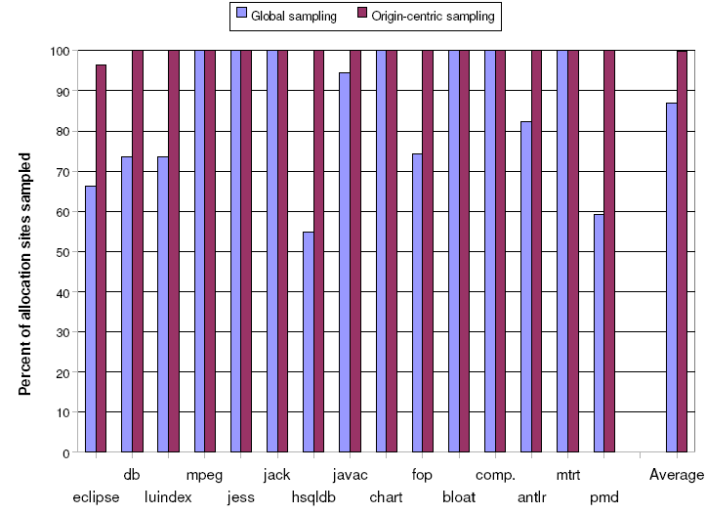
Sampling Coverage (Typestate)

